Slide 1

SLIDE 1
1.Team name - ROCKERS
2.LEADER NAME-NAVANEESH K M(7825054279)
3.TEAM MEMEBERS NAME – SUGAN G,SHALINI S R,SOUNDHARYA G
4.DOMAIN NAME – ELECTRICAL AND ELECTRONICS ENGINEERING
5. Problem statement –We all know that nowadays accidents are more in india and also the information of accident happen is not reaching the family members at right time.To avoid accidents and send information at right time this will be help full.

Slide 2
ABSTRACT
SLIDE 2
FUNCTION OF ACCIDENT DETECTION AND ALERTNESS
When a vehicle is coming with too much of speed in the opposite the Ultrasonic sensor detects and send it to the Raspberry Pi .And the Raspberry stop the engine from running .suppose after the engine is stopped when the vehicle is hidden by another vehicle or lorries and it is fallen down . Automatically the buzzer will on and create some noise to create an alertness to the people around the accident zone. And the Arduino will send the message to the persons friends and family members about the accident .It also shares the location of the accident where it is taken place.

Slide 3
SLIDE 3
NOVELTY
This accident detection method will help the government to reduce accidents

Slide 4
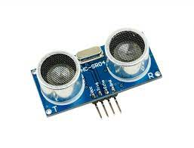
TECHNOLOGIES USED
SLIDE 4
ULTRASONIC SENSOR
Ultrasonic sensor is an electronic device that measures the distance of a target object by emitting ultrasonic sound waves. Here in this case of accident detection and alertness ultrasonic sensor is fitted in front and back of the vehicle to detect the vehicles and lorries which are coming with too much speed .Within a range of 300meters it detects the vehicles and lorries which are coming with too much speed.

Slide 5
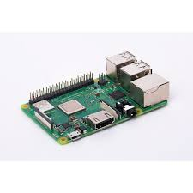
HARDWARE SOFTWARE IMPLEMENTATION
SLIDE 5
RASPBERRY PI CONTROLLER
Raspberry pi is a low cost ,credit card sized computer that plugs into a computer monitor on TV ,and uses a standard keyboard and mouse. Here in this case accident detection and alertness Raspberry pi acts as a controller and controls the entire system to function. It also detects the speed of the vehicle or lorries which is coming in the opposite.

Slide 6
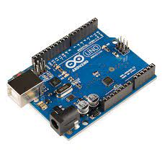
ARDUINO
Arduino is an single board micro controller .It is the place where the program is written. In this of accident detection and alertness Arduino will act as an operating system and will detect the vehicles by using ultrasonic sensor and also when the vehicle is fallen it creates and alertness. And also when the vehicle is fallen it sends messages to the persons family.

Slide 7
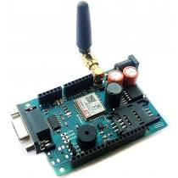
GSM MODULE
A GSM Module is a hardware device that uses GSM mobile telephone to provide a data link to a remote network. Here in this case of accident detection and alertness when the accident happen this GSM Module will send the message to the persons family

Slide 8
BUSINESS SCOPE
SLIDE 6
This will rule the future world in the field of vehicles especially in EV because it comprises all the security systems and also instant information sending using modern technologies.

